Slide 1
Review of the Legislative and Code Development Process
Linda Hale
Loudoun County Chief Fire Marshal

Slide 2
Agenda for next 60 minutes
Code Change Process
2018 SFPC highlights
  New Chapters in 2018 IFC
  Removal of the “N”s and the Supplemental Section
  Code changes we expect to see

Slide 3
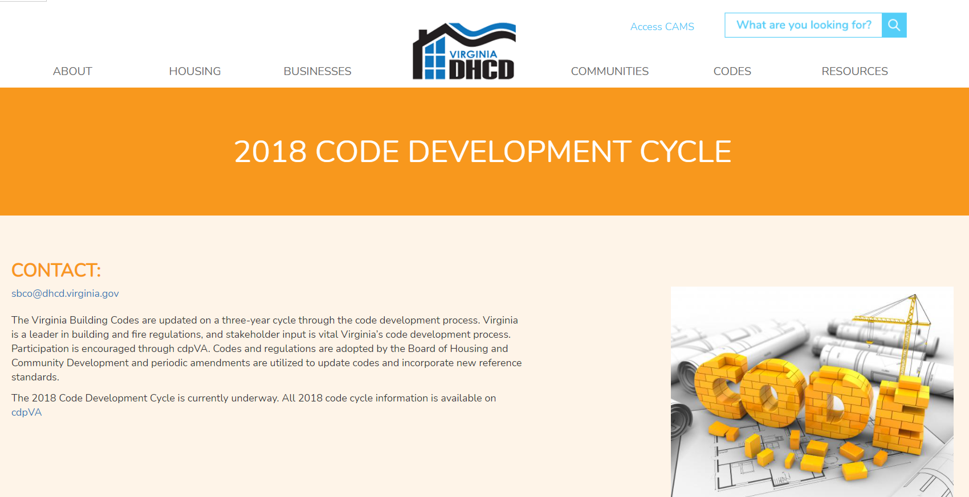
Code Change Process
2018 Code Development Cycle | DHCD (virginia.gov)

Slide 4
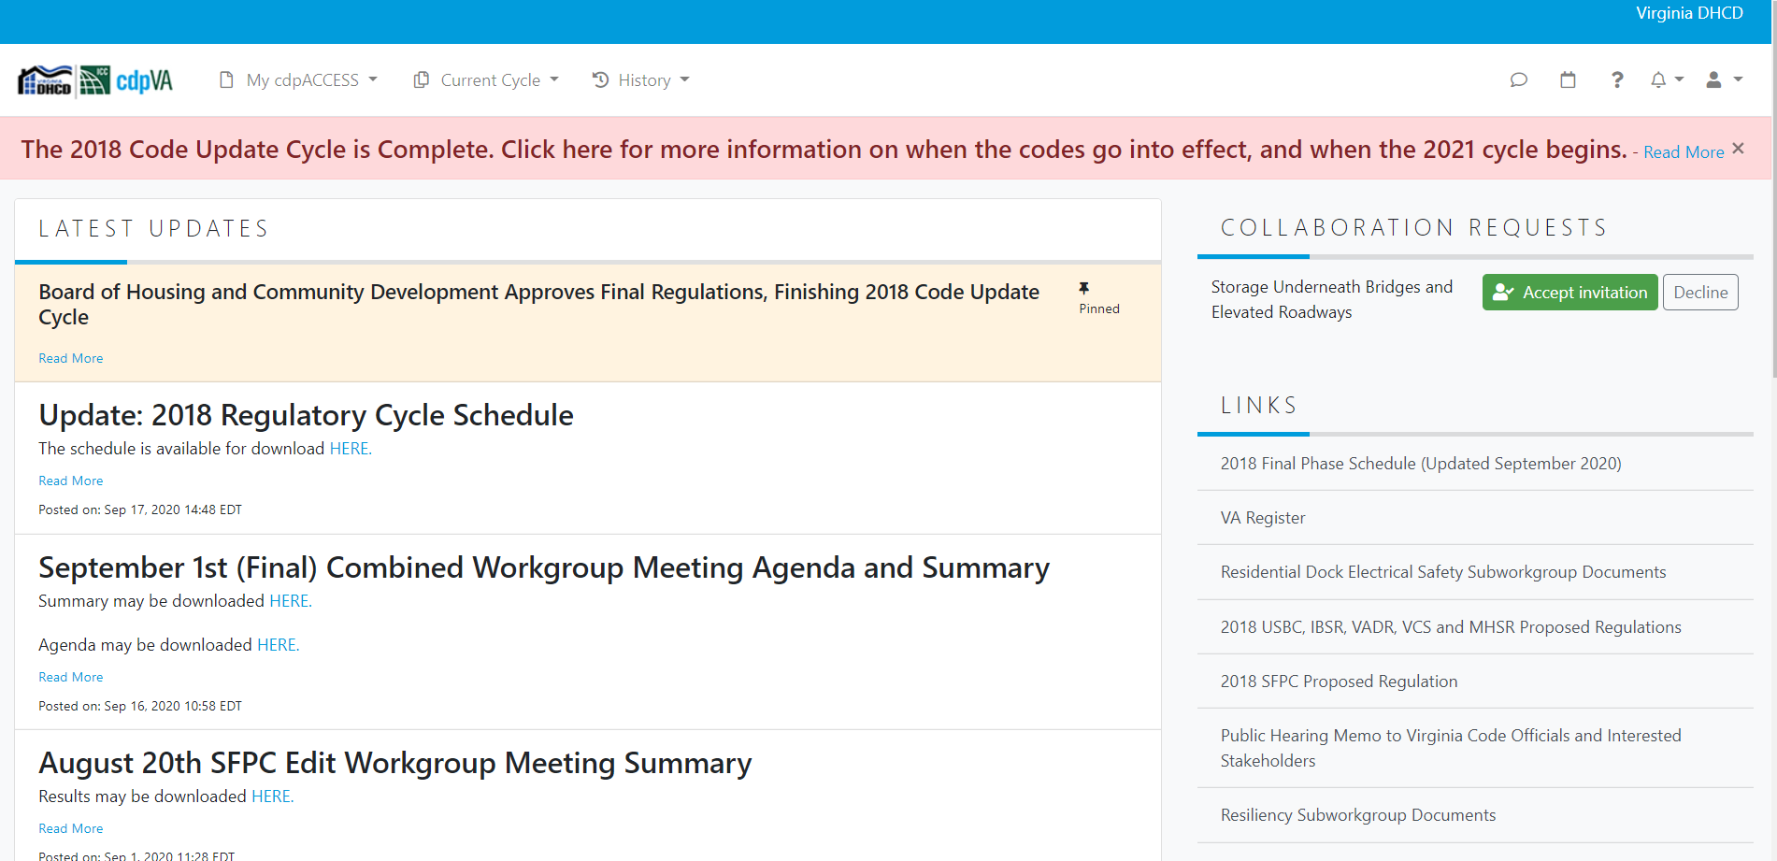
Code Change Process
2018 Code Development Cycle | DHCD (virginia.gov)

Slide 5
2018 SFPC highlights of what code changes we expect to see
New Chapters
  Chapter 12 on Energy Systems—for the operation, and maintenance of energy systems used for generating or storing energy
  Chapter 38 on Higher Education Laboratories
  Chapter 39 on Plant Processing and Oil Extraction Facilities
Notes:
2018 IFC Chapter 12: Energy Systems
A new chapter has been added to the IFC for energy systems
Some items from Chapter 6 were moved to this chapter
2018 IFC Chapter 38: Higher Education Laboratories
A new chapter has been added to the IFC to specifically regulate college and university laboratories.
Correlating sections have been added to a new Section 427 in the IBC.
2018 IFC Chapter 39: Plant Processing and Oil Extraction Facilities
A new chapter has been added to the IFC to specifically regulate the process of extracting oils from plant material.

Slide 6
2018 SFPC highlights of what code changes we expect to see
Section numbers preceded by "(N)" indicate sections of the IFC that have been changed to remove construction-related provisions that are outside of the scope of the SFPC.
This has been stricken so no more appendix with “N”

Slide 7
2018 SFPC highlights of what code changes we expect to see
Table 107.2 OPERATIONAL PERMIT REQUIREMENTS (to be filled in by local jurisdiction)
  Commercial Cooking. An operational permit is required for the operation of commercial cooking appliances in occupancies other than assembly occupancies or dwellings.
  SRCFs. An operational permit is required for the operation of a State-Regulated Care Facility where inspection by the fire official is required by state licensing regulations
Notes:
This proposal adds an additional operational permit for localities to consider using to protect their restaurant and commercial cooking businesses.
The numbers speak for themselves regarding the hazard and financial impact that theses fires have in communities throughout the Commonwealth and nation.
According to the NFPA, approximately 61% of all restaurant fires between 2010 and 2014 were caused by cooking – with cooking equipment or materials being the most frequent items initially ignited and therefore the cause of the fire. This makes up three out of five fires and 38% of direct property damage.
Approximately 22% of these fires were a result of failure to clean, 14% electrical failure or malfunction, 12% mechanical failure or malfunction and 8% unattended equipment. Deep fryers were involved in one of five fires (21%), ranges or cooktops in 14% of fires, cooking grills in 6%, and ovens or rotisserie ovens in 5%. These fires resulted in direct property damage of $165 million annually.
Although permits are already required for locations that have occupant loads of more than 50 persons (Assembly), there are numerous cooking operations that are not routinely inspected to ensure that proper cleaning and maintenance is being completed.
In fact, even food trucks with commercial cooking equipment with grease-laden vapors are subject to permits and inspections but similar operations in "brick and mortar“ businesses that are often attached to other occupied spaces have no such requirement.
This proposal intends to provide communities with the ability to ensure that these hazards are being properly operated and maintained.
This proposal adds an additional operational permit for localities to consider using to protect their State Regulated Care Facilities (SCFRs) and recover costs from state-mandated inspections.
Administrative regulation changes in the Department of Social Services and other agencies regulating SRCFs have recently changed to require inspection of childcare and other facilities by the local fire official (22VAC40-185- 260 - https://www.dss.virginia.gov/family/cc/index.cgi).
Prior to this change, such requests were less frequent, and most localities simply preformed this inspection without cost recovery.
Given the increasing demands on local agency staff and limited budgets, it is important to provide these agencies a means for cost recovery of this mandated service.
This proposal intends to provide communities with the ability for cost recovery while making sure that these hazards are being properly operated and maintained.

Slide 8
2018 SFPC highlights of what code changes we expect to see
Chapter 2 Definitions
  202 Cooking Tent Definition Cooking Tent. A structure, enclosure or shelter, with or with-out sidewalls or drops, constructed of fabric or pliable material supported by any manner except by air or the contents that it protects, and which contains cooking equipment that utilize open flames or produce smoke or grease laden vapors for the purpose of preparing and serving food to the public.
Notes:
Section 3104.15.5 cooking tents requires no less than 20 feet of separation to be provided from a cooking tent to other tents or membrane structures.
This section does refer to "cooking" in the definition, but there is no definition or specifics of what this might entail.
This has created conflicts with the health department’s requirement to have any "cooking" surface covered from the sky.
And what the specifics of cooking entails.
The definition of cooking is to "to prepare (food) for eating by applying heat." By this technical definition a sterno can on a steam table is cooking as it applies heat to keep the water bath warm. I do not believe that was the intended rational for separating a "cooking tent".
This definition is need to assure there is a clear understanding of what "cooking" specifically is for a tent that drives the separation.

Slide 9
2018 SFPC highlights of what code changes we expect to see
3107.12.5 Cooking tents. Cooking Tents with sidewalls or drops where cooking is performed shall be separated from other tents or membrane structures by not less than 20 feet (6096 mm).
Notes:
This separation requirement is consistent with the overall requirement covering open or exposed flames.
The inclusion of sides and drops does increase the speed and degree of accumulation of grease from cooking operations that create smoke and/or grease laden vapors, but a simple canopy also collects these flammable substances posing a fire risk to adjoining assembly tents.
This is no different than a pavilion built over a smoke that the USBC would prohibit for the same rationale for fire risk.
The 20-foot (6096 mm) separation provides protection from hot embers from a fire reaching the main membrane structure.
The requirements for keeping the open area free of combustible materials or debris that could limit access to emergency response personnel also apply

Slide 10
2018 SFPC highlights of what code changes we expect to see
316.6; 316.1.6; 316.2 Structures and Outdoor Storage Underneath High Voltage Transmission Lines, Bridges and Elevated Roadways
Notes:
Must be non-combustible storage
South Fork Bridge Warren County
Atlanta Georgia Bridge Collapse

Slide 11
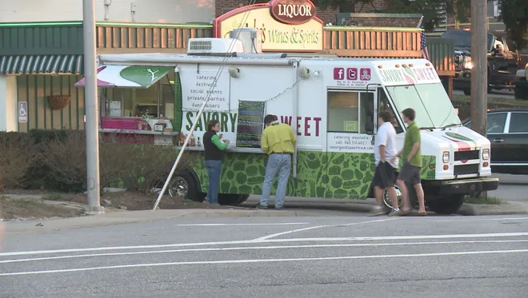
Is this a Problem?

Slide 12
2018 SFPC highlights of what code changes we expect to see
319.1.1 Wheel Chocks Wheel Chocks shall be used to prevent mobile food preparation vehicles from moving
319.1.2 Separation Mobile food preparation vehicles shall be separated from buildings or structures, combustible materials, vehicles, and other cooking operations by a minimum of 10 ft. (3m).
319.2.1 Permit Authority Having Jurisdiction (AHJ). The enforcing agent of a permit requirement on a mobile food preparation vehicle (MFPV) shall be the appointed fire official for the Virginia local government which the food truck is identified for personal property tax payment of the vehicle. If no such entity exists, if the local government has elected to not enforce this section of the SFPC, or if the MFPV is housed out of state, then it shall be the State Fire Marshal’s Office (SFMO) or designee.
Notes:
Mobile Food Preparation Vehicles have become a common commodity for venues seeking to serve hot food either inside or
outside.
But which do not desire to install a commercial kitchen in compliance with the USBC or a restaurant as defined in Section 35.1-1 of the
Code of Virginia and licensed as such by the Board of Health.
These vehicles typically use LPG or solid fuel to heat and cook the food. As such they should minimally maintain the same separation distance as any open flame cooking device such as a charcoal burner or LPG grill from buildings or other combustible construction. We have found non-road worthy MFPV located on unprotected loading docks set up against the structure and under the loading dock canopy, attached to buildings, or daisy chained together. These are hazards that the building was not designed to withstand, and create an increased hazard to the occupants
A locality in which the food truck is identified for personal property tax payment is the only jurisdiction that may require a permit. There must be some guidance on who may require a permit for a mobile food preparation vehicle. This does not stop a locality or the SFMO from conduction a life safety inspection when a MFPV is parked with the intention of operating or is operating within their jurisdiction. But a food vendor should not be forced to drive 4 hours to an AHJ so that they may conduct an inspection and garner a permit so that the vendor may return later for a venue in which they are participating. The locality is welcome to conduct an inspection on the day of the venue but not require a permit, fee and forced road trip

Slide 13
2018 SFPC highlights of what code changes we expect to see
TABLE 405.2 FIRE AND EVACUATION DRILL FREQUENCY AND PARTICIPATION
  Emergency evacuation drills in Group R-2 college and university buildings shall be in accordance with Section 403.10.2.1. Emergency evacuation drills are required in Group R-2 occupancies that are designed or developed and marketed to senior citizens 55 years of age or older in accordance with 42 U.S. Code, Section 3607(b)(2). Other Group R-2 occupancies do not require routine emergency evacuation drills but shall be in accordance with Section 403.10.2.2.
Notes:
The 2015 IFC (and therefore the 2015 VSFPC) brought in a new requirement that mandates evacuation drills for all R-2 occupancies 4 times annually.
The code and commentary are not clear if this was intended to apply so broadly however when reading it as currently written, the 2018 IFC would do the same. This proposal does two things.
First, it looks to clear up the confusion about which R-2 occupancies require evacuation drills 4 times per year.
It also intends to highlight and start to address an increasing population risk in our communities by focusing attention on the ability of occupants to physically evacuate during an emergency. By requiring these evacuation drills for a building where the majority of residents are 55 years of age or older, ambulatory ability concerns can be identified prior to an actual emergency incident.
According to the National Fire Protection Association, at age 65 or older, people are twice as likely to be killed or injured by fires compared to the population at large.
In fact they indicate that over half of all fire deaths in residential buildings from 2011-2015 were those who are 55 years of age or older. This proposal is intended to correct the recent confusion about broadly required R-2 occupancy evacuation drills as well as focus the requirement on an increasing hazard area within our communities.

Slide 14
2018 SFPC highlights of what code changes we expect to see
407.2 Material Safety Data Sheets. Material Safety Data Sheets (MSDS) (SDS) for all hazardous materials shall be either readily available on the premises as a paper copy , or where approved, shall be permitted to be readily retrievable by electronic access.
Notes:
OSHA accepted electronic MSDS programs as early as July 1989 when fax-on-demand programs were just beginning. 30 years later, as technology has improved, it's now faster and safer for someone to receive an SDS (or database of SDSs) over email or a smartphone app or speaking with a knowledgeable person over a phone than it is to send somebody into a building to retrieve a paper copy from a binder. Some companies manage such programs internally, but others use time-tested 3rd party providers such as ChemTel, Infotrac, Verisk 3E, or
KHA to name a few.
Electronic versions can also be updated near instantaneously as changes in products and inventories are made, while paper copies have to be pulled, new ones printed, and then reinserted into the binder. This ease of use not only helps electronic users be compliant, but also helps ensure first responders have a faster, more accurate, and up to date SDS list to review in hazardous times.
Allowing for both paper and electronic SDS programs inherently, rather than electronic programs only when approved by Authorities Having
Jurisdiction, will be for the betterment of businesses, communities, and first responders.

Slide 15
2018 SFPC highlights of what code changes we expect to see
609.2 Where required. Commercial Cooking Operations. A Type I hood shall be installed Where ventilation is provided or required by the applicable building code at or above all commercial cooking appliances and domestic cooking appliances used for commercial purposes that produce grease vapors in mobile food preparation vehicles. , ventilation shall be operated and maintained. The fire code official is not authorized to require alteration or installation of a ventilation hood in accordance with SFPC Section 102.6.
  Exception: A Type I hood shall not be required for an electric cooking appliance where an approved testing agency provides documentation that the appliance effluent contains 5 mg/m or less of grease when tested at an exhaust flow rate of 500 cfm (0.236 m /s) in accordance with UL 710B.
Notes:
This proposal restores a key enforcement tool for ensuring proper ventilation during cooking operations while directing the user to the applicable building code and ultimately the building official for the proper type of ventilation.
This proposal provides the bridge between the fire code official and the building code official to effectively manage the single leading cause of fires.
The revision to the proposal uses language recommended by DHCD staff at the latest workgroup session. Further discussion with VBCOA and other stakeholders achieved consensus with this language.

Slide 16
2018 SFPC highlights of what code changes we expect to see
807.5.4 Group I-3. In Group I-3, combustible decorative materials are prohibited.
  EXCEPTION
  Cell areas in buildings equipped throughout with an automatic sprinkler system in accordance with the applicable NFPA 13 standard where a maximum 4 sq. ft. area has been demarcated on the wall for personal items 0.025 inch (0.64 mm) or less in thickness applied directly to and adhering to the wall.
Notes:
We are seeking to make this section more enforceable by permitting a very small amount of personal affects to be attached and adhered to the wall of an offenders cell space when fully protected by a sprinkler system.
It is nearly impossible to keep offenders from attaching some type of combustible material to their personal cell walls.
The risks associated with permitting a small amount material is greatly reduced by the presence of sprinklers and the placement of the demarcated area (away from other combustibles).
The area can be better monitored and the demarcated space by visual inspection quickly insures the limit is not exceeded.
We feel this change is warranted by the low occurrence of I-3 fires, 24 hour staff monitoring, presence of sprinkler systems and typically smoke detection within the cell.

Slide 17
2018 SFPC highlights of what code changes we expect to see
2306.2.1 Underground tanks. Underground tanks for the storage of Class I, II and IIIA liquid fuels shall comply with Chapter 57. For tanks subject to the State Water Control Board Regulations 9VAC25-580, see Section 5701.1.1
2306.2.2 Aboveground tanks located inside buildings. Aboveground tanks for the storage of Classes I, II and IIIA liquid fuels located in buildings shall be maintained in accordance with the applicable building code. For tanks subject to the State Water Control Board Regulations 9VAC25-91, see Section 5701.1.1
2306.2.3 Aboveground tanks located outside above grade. Aboveground tanks located outside shall be maintained in accordance with the applicable building code. For tanks subject to the State Water Control Board Regulations 9VAC25-91, see Section 5701.1.1
2306.2.4 Aboveground tanks located in above grade vaults or below-grade vaults. Aboveground tanks located in above-grade vaults or below-grade vaults shall be maintained in accordance with the applicable building code. For tanks subject to the State Water Control Board Regulations 9VAC25-91, see Section 5701.1.1
Notes:
Provides pointers for State Water Control Board Regulations (SWCB) regulated tanks

Slide 18
2018 SFPC highlights of what code changes we expect to see
3605.1 Fuel dispensing. Marine motor fuel-dispensing facilities shall be in accordance with Chapter 23. For tanks subject to the State Water Control Board Regulations 9VAC25-91 or 9VAC25-580, see Section 5701.1.1
5003.2.4 Installation of tanks. Installation of tanks shall be in accordance with Sections 5003.2.4.1 through 5003.2.4.2.1. For tanks subject to the State Water Control Board Regulations 9VAC25-91 or 9VAC25-580, see Section 5701.1.1
5704.1 General. The storage of flammable and combustible liquids in containers and tanks shall be in accordance with this section and the applicable sections of Chapter 50. For tanks subject to the State Water Control Board Regulations 9VAC25-91 or 9VAC25-580, see Section 5701.1.1
5704.2.9 Aboveground tanks. Aboveground storage of flammable and combustible liquids in tanks shall be maintained in accordance with the applicable building code. For tanks subject to the State Water Control Board Regulations 9VAC25-91, see Section 5701.1.1
5704.2.11 Underground tanks. Underground storage of flammable and combustible liquids in tanks shall be maintained in accordance with the applicable building code. For tanks subject to the State Water Control Board Regulations 9VAC25-580, see Section 5701.1.1
Notes:
Provides pointers for State Water Control Board Regulations (SWCB) regulated tanks

Slide 19
2018 SFPC highlights of what code changes we expect to see
2306.2.1.1 Inventory control and leak detection records for underground tanks. Accurate inventory records shall be maintained on underground fuel storage tanks for indication of possible leakage from tanks and piping. The records shall be kept at the premises or made available for inspection by the fire official within 24 hours of a written or verbal request and shall include records for each tank. Where there is more than one system consisting of tanks serving separate pumps or dispensers for a product, the inventory record shall be maintained separately for each tank system.
A consistent or accidental loss of product shall be immediately reported to the fire official.
2306.2.1.2 Release detection for State Water Control Board regulated underground tanks Underground storage tank systems subject to the Virginia State Water Control Board regulation 9VAC25-580 shall comply with the release detection requirements of 9VAC25-580-130.
Notes:
2306.2.1.1 Inventory control and leak detection records for underground tanks.
Owners and operators of underground fuel storage tanks shall provide release detection for tanks and piping that routinely contain flammable and combustible liquids in accordance with one of the following methods:
1. Monthly inventory control to detect a release of at least 1.0 percent of flow-through plus 130 gallons (492 L).
2. Manual tank gauging for tanks with 2,000 gallon (7571 L) capacity or less when measurements are taken at the beginning and ending of a 36-hour to 58-hour period during which no liquid is added to or removed from the tank.
3. Tank tightness testing capable of detecting a 0.1 gallon (0.4 L) per hour leak rate.
4. Automatic tank gauging that tests for loss of liquid.
5. Vapor monitoring for vapors within the soil of the tank field.
6. Groundwater monitoring when the groundwater is never more than 20 feet (6096 mm) from the ground surface.
7. Interstitial monitoring between the underground tank and a secondary barrier immediately around or beneath the tank.
8. Other approved methods that have been demonstrated to be as effective in detecting a leak as the methods listed above.
2306.2.1.2 Release detection for State Water Control Board regulated underground tanks Initial release detection methods were provided in 2306.2.1.1 to correlate with specific methods listed in the State Water Control Board regulations.
In an effort to mitigate differences between the SFPC and the SWCB regs due to the specific requirements in the SWCB changing at different times than the SFPC, it is more prudent to reference the section in the SWCB than the specific requirements themselves.

Slide 20
2018 SFPC highlights of what code changes we expect to see
5704.2.13.1.1 Temporarily out of service. Underground tanks temporarily out of service shall have the fill line, gauge opening, vapor return and pump connection secure against tampering. Vent lines shall remain open and be maintained in accordance with Sections 5704.2.7.3 and 5704.2.7.4.
Exception: Underground storage tank systems subject to the Virginia State Water Control Board regulation 9VAC25-580 that are out-of-service shall comply with the temporary closure requirements of 9VAC25-580-310.
5704.2.13.1.3 Out of service for one year. Underground tanks that have been out of service for a period of one year shall be removed from the ground in accordance with Section 5704.2.14 or abandoned in place in accordance with Section 5704.2.13.1.4.
Exception: Underground storage tanks tank systems subject to the Virginia State Water Control Board regulation 9VAC25-580 that are in compliance with the performance standards of 9VAC25-580-50 and 9VAC25-580-60 are allowed to remain temporarily closed for a period of more than one year in accordance with 9VAC25-580-310 as part of the Virginia Department of Environmental Quality’s program.
Notes:
Makes reference to the SWCB regulation section since there are some specific requirements that are different from the requirements in this section.

Slide 21
2018 SFPC highlights of what code changes we expect to see
2403.2.1.3 Areas adjacent to spray booths. Electrical wiring and equipment located outside of, but within 5 feet (1524 mm) 3 feet (915mm) horizontally and 3 feet (914 mm) (915mm) vertically of, openings in a spray booth or a spray room shall be maintained in accordance with the applicable building code.
Notes:
2306.2.1.1 Inventory control and leak detection records for underground tanks.
Owners and operators of underground fuel storage tanks shall provide release detection for tanks and piping that routinely contain flammable and combustible liquids in accordance with one of the following methods:
1. Monthly inventory control to detect a release of at least 1.0 percent of flow-through plus 130 gallons (492 L).
2. Manual tank gauging for tanks with 2,000 gallon (7571 L) capacity or less when measurements are taken at the beginning and ending of a 36-hour to 58-hour period during which no liquid is added to or removed from the tank.
3. Tank tightness testing capable of detecting a 0.1 gallon (0.4 L) per hour leak rate.
4. Automatic tank gauging that tests for loss of liquid.
5. Vapor monitoring for vapors within the soil of the tank field.
6. Groundwater monitoring when the groundwater is never more than 20 feet (6096 mm) from the ground surface.
7. Interstitial monitoring between the underground tank and a secondary barrier immediately around or beneath the tank.
8. Other 2403.2.1.3 2403.2.1.3 Areas adjacent to spray booths. Electrical wiring and equipment located outside of, but within 5 feet (1524 mm) 3 feet
(915mm) horizontally and 3 feet (914 mm) (915mm) vertically of, openings in a spray booth or a spray room shall be maintained in accordance with
the applicable building code.
The purpose behind this code change is create consistency in defining the classified area outside of a spray booth. NFPA 70, NFPA 33 (Standard for Spray Application Using Flammable or Combustible Materials) and International Fire Code all list this area to be 3 feet horizontally from any opening and 3 feet vertically from any opening.
The Virginia Statewide Fire Prevention Code still lists the classified area to be 5 feet horizontally and 3 feet vertically from any opening.
In order to avoid any potential conflicts in enforcement and maintenance provisions, I respectfully request The Virginia Statewide Fire Prevention Code be amended as noted to create consistency amongst the Codes and referenced standards.
The code change proposal will decrease the cost of construction
The consistency amongst the codes to create a 3 feet area around the opening at the spray booth will potentially decrease the cost of construction by creating an equal standard of enforcement and maintenance amongst all the codes.
In addition to the obvious cost savings of not having to use specialized electrical equipment and methods in that 3-5 foot range, this amendment will prevent potentially costly delays in construction and potential change orders.
There is no expected change to resiliency to this code change as the 3 foot horizontal dimension has been the standard by NFPA 70 since at least 1978.

Slide 22
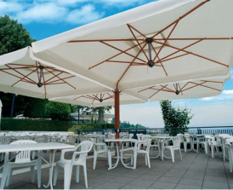
Chapter 31 now includes Umbrella Structures

Slide 23
Inclusion of Emergency Barricade Devices
110.1.1Consultation and Notification.
  Prior to approval of emergency supplemental hardware, the building code official shall consult with the local fire code official or state fire code official if no local fire code official exists, and head of the local law enforcement agency. The local fire code official, the state fire code official, and the local fire, EMS and law enforcement first responders shall be notified of such approval, after approval of such emergency supplemental hardware by the building code official.
  EMERGENCY SUPPLEMENTAL HARDWARE.
    Any approved hardware used only for emergency events or drills to keep intruders from entering the room during an active shooter or hostile threat event or drill.
Notes:
New Code Section on EMERGENCY SUPPLEMENTAL HARDWARE in 2018 USBC

Slide 24
2018 Uniform Statewide Building Code
1010.1.4.4 Locking arrangements in educational occupancies. In Group E occupancies, except Group E day care facilities, and Group B educational occupancies, exit access doors from classrooms, offices and other occupied rooms, except for exit doors and doors across corridors, shall be permitted to be provided emergency supplemental hardware where all of the following conditions are met:
The door shall be capable of being opened ​​​from outside the room with a key, proprietary device provided by the manufacturer, or other approved means.
The door shall be openable from within the room in accordance with Section 1010.1.9, except emergency supplemental hardware is not required to comply with Chapter 11.
NOTE: School officials should consult with their legal counsel regarding provisions of the Americans with Disabilities Act and any other applicable requirements.
Notes:
This proposal allows limited types of barricade door devices in Group E and B educational occupancies only, by “taking over” the current 2018 IBC language and adding exceptions to the various door-related requirements to allow such hardware. A barricade door device would not necessarily need to go through the code modification process in accordance with VCC 106.3, unless it was a type that did not comply with the “openable from outside,” limited height above finished floor requirements, and has a fixed component to function, among others.

Slide 25
2018 Uniform Statewide Building Code
Installation of emergency supplemental hardware on fire door assemblies must comply with Section 716.2. Modifications shall not be made to listed panic hardware, fire door hardware or door closers.
The emergency supplemental hardware shall not be capable of being used on other doors not intended to be used and shall at least one component that requires modification to, or is permanently affixed to, the surrounding wall, floor, door and/or frame assembly construction for it to properly function.
Employees shall engage in lockdown training procedures on how to deploy and remove the emergency supplemental hardware and its use shall be incorporated in the approved lockdown plan complying with the SFPC.
The emergency supplemental hardware and its components shall be maintained in accordance with the SFPC.
Notes:
This proposal allows limited types of barricade door devices in Group E and B educational occupancies only, by “taking over” the current 2018 IBC language and adding exceptions to the various door-related requirements to allow such hardware. A barricade door device would not necessarily need to go through the code modification process in accordance with VCC 106.3, unless it was a type that did not comply with the “openable from outside,” limited height above finished floor requirements, and has a fixed component to function, among others.

Slide 26
2018 Uniform Statewide Building Code
Approved emergency supplemental hardware shall be of consistent type throughout a building.
Exception: The building official may approve alternate types of emergency supplemental hardware in accordance with Section 110.1 when a consistent device cannot be installed.
Notes:
This proposal allows limited types of barricade door devices in Group E and B educational occupancies only, by “taking over” the current 2018 IBC language and adding exceptions to the various door-related requirements to allow such hardware. A barricade door device would not necessarily need to go through the code modification process in accordance with VCC 106.3, unless it was a type that did not comply with the “openable from outside,” limited height above finished floor requirements, and has a fixed component to function, among others.

Slide 27
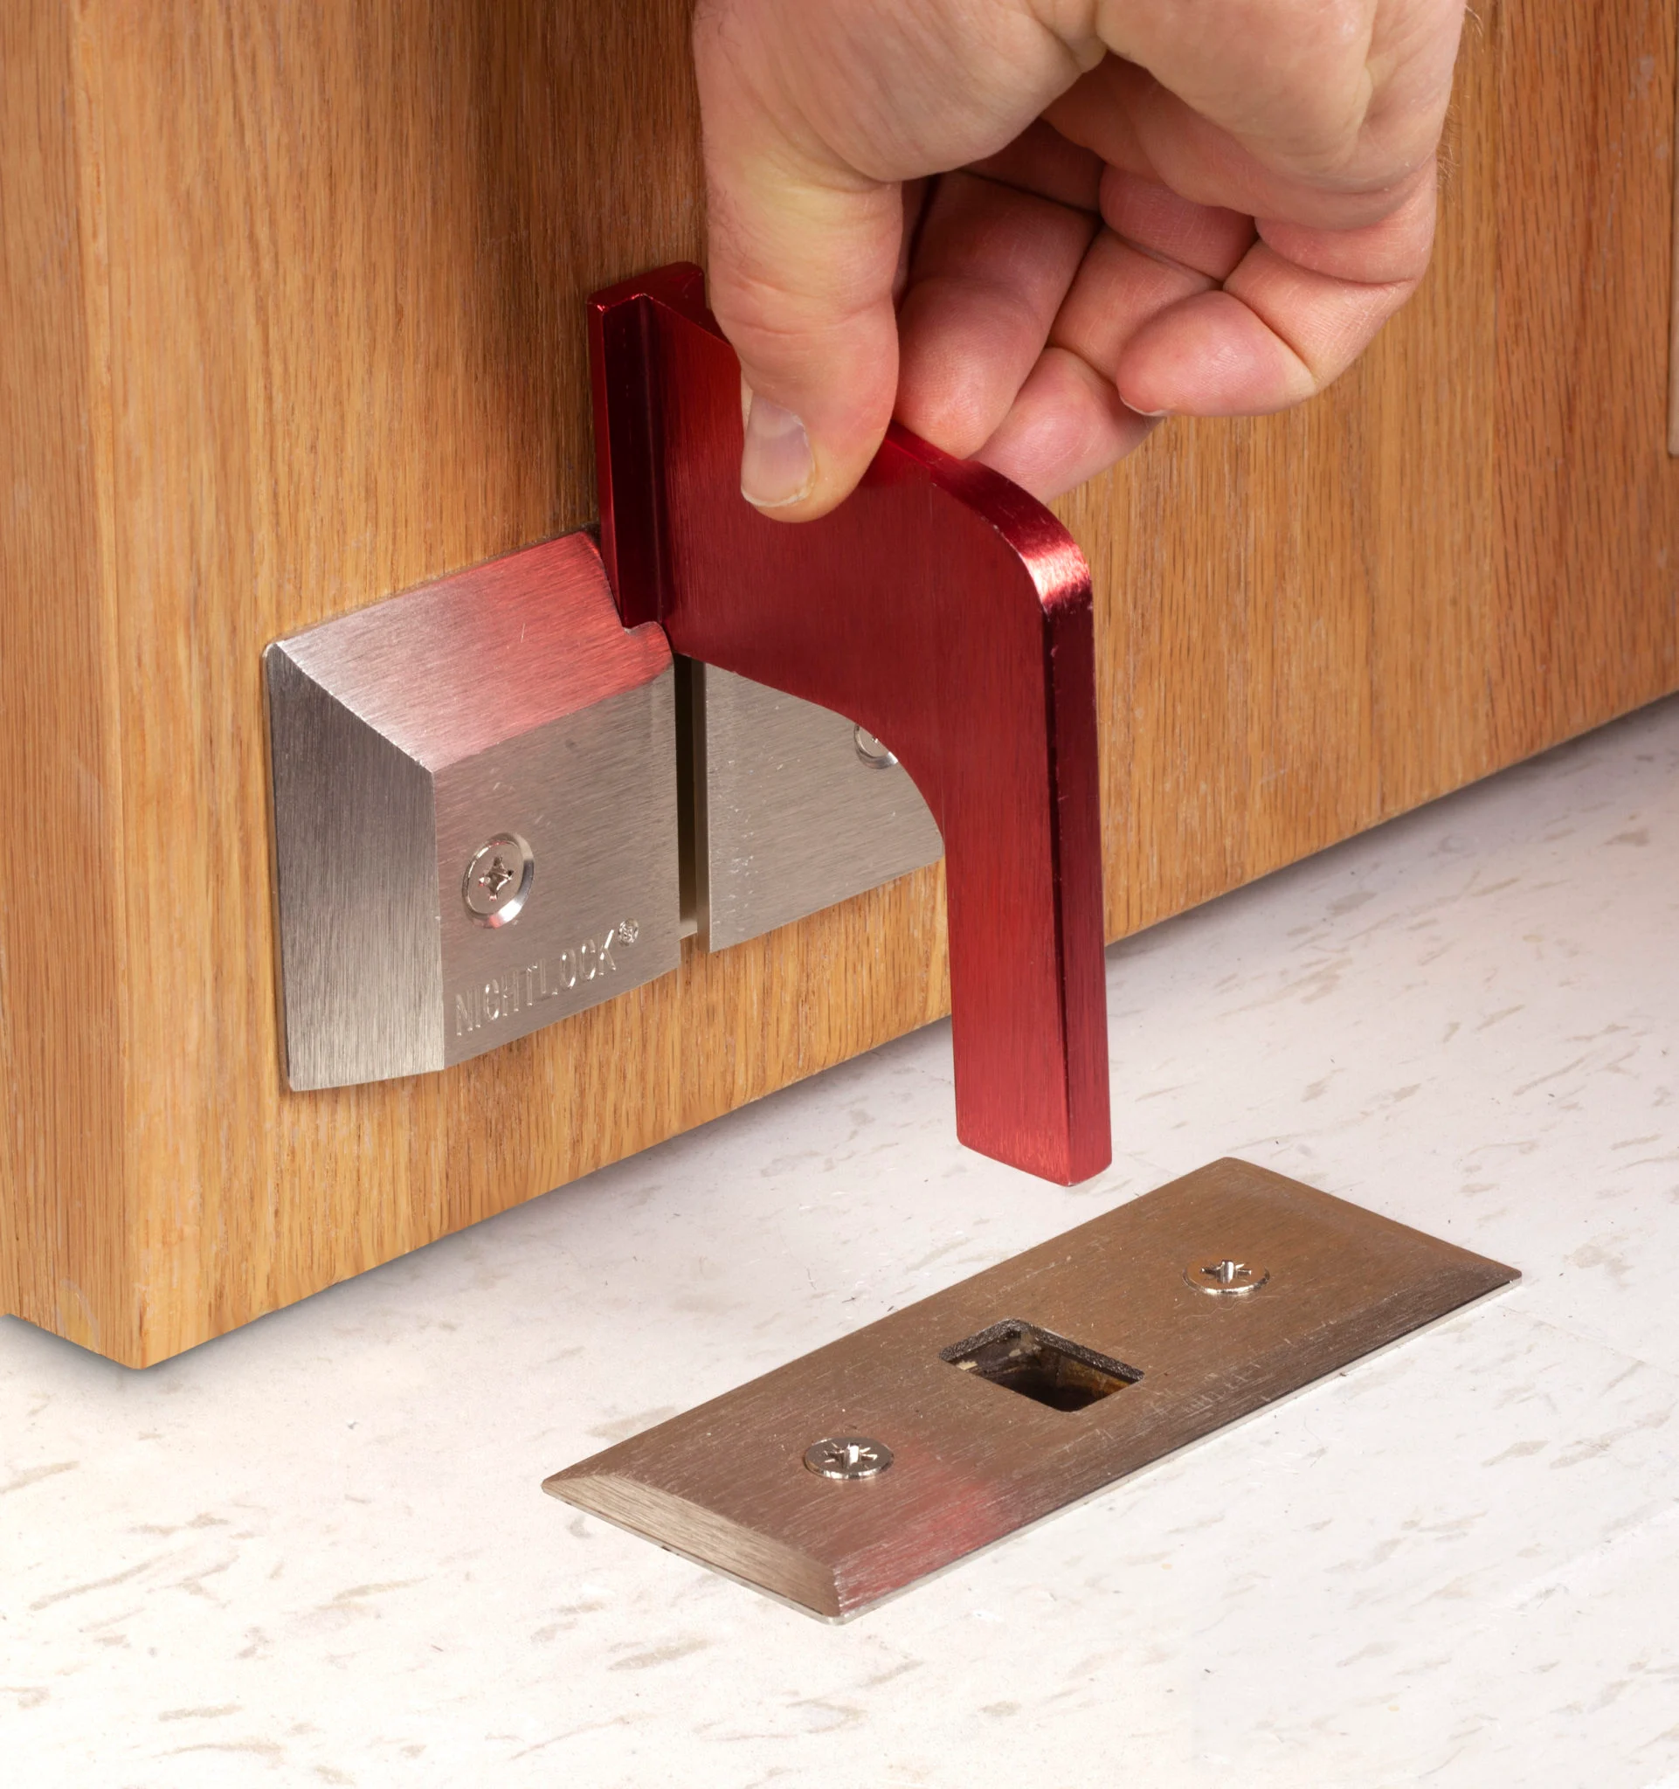
Retail Price $59.95

Slide 28
2018 Uniform Statewide Building Code
1010.1.4.4.1Remote operation of locks. Remote operation of locks complying with Section 1010.1.4.4 shall be permitted.
1010.1.9 Door Operations. Except as specifically permitted by this section, egress doors shall be readily openable from the egress side without the use of a key or special knowledge or effort.
Exception: Emergency supplemental hardware provided in accordance with Section 1010.1.4.4.
1010.1.9.1Hardware. Door handles, pulls, latches, locks and other operating devices on doors required to be accessible by Chapter 11 shall not require tight grasping, tight pinching or twisting of the wrist to operate.
Exception: Emergency supplemental hardware provided in accordance with Section 1010.1.4.4.
Notes:
This proposal allows limited types of barricade door devices in Group E and B educational occupancies only, by “taking over” the current 2018 IBC language and adding exceptions to the various door-related requirements to allow such hardware. A barricade door device would not necessarily need to go through the code modification process in accordance with VCC 106.3, unless it was a type that did not comply with the “openable from outside,” limited height above finished floor requirements, and has a fixed component to function, among others.

Slide 29
2018 Uniform Statewide Building Code
1010.1.9.2 Hardware height. Door handles, pulls, latches, locks and other operating devices shall be installed 34 inches (864 mm) minimum and 48 inches (1219 mm) maximum above the finished floor. Emergency supplemental hardware provided in accordance with Section 1010.1.4.4,shall be installed 48 inches (1219 mm) maximum above the finished floor. Locks used only for security purposes and not used for normal operation are permitted at any height.
Exception: Access doors or gates in barrier walls and fences protecting pools, spas and hot tubs shall be permitted to have operable parts of the latch release on self-latching devices at 54 inches (1370 mm) maximum above the finished floor or ground, provided that the self-latching devices are not also self-locking devices operated by means of a key, electronic opener or integral combination lock.
Notes:
This proposal allows limited types of barricade door devices in Group E and B educational occupancies only, by “taking over” the current 2018 IBC language and adding exceptions to the various door-related requirements to allow such hardware. A barricade door device would not necessarily need to go through the code modification process in accordance with VCC 106.3, unless it was a type that did not comply with the “openable from outside,” limited height above finished floor requirements, and has a fixed component to function, among others.

Slide 30
2018 Uniform Statewide Building Code
1010.1.9.4Locks and latches. Locks and latches shall be permitted to prevent operation of doors where any of the following exist:
1. Places of detention or restraint.
2. In buildings in occupancy Group A having an occupant load of 300 or less, Groups B, F, M and S, and in places of religious worship, the main door or doors are permitted to be equipped with key-operated locking devices from the egress side provided:
2.1.The locking device is readily distinguishable as locked.
2.2. A readily visible durable sign is posted on the egress side on or adjacent to the door stating: THIS DOOR TO REMAIN UNLOCKED WHEN THIS SPACE IS OCCUPIED. The sign shall be in letters 1 inch (25 mm) high on a contrasting background.
2.3. The use of the key-operated locking device is revocable by the building official for due cause.
Notes:
This proposal allows limited types of barricade door devices in Group E and B educational occupancies only, by “taking over” the current 2018 IBC language and adding exceptions to the various door-related requirements to allow such hardware. A barricade door device would not necessarily need to go through the code modification process in accordance with VCC 106.3, unless it was a type that did not comply with the “openable from outside,” limited height above finished floor requirements, and has a fixed component to function, among others.

Slide 31
2018 Uniform Statewide Building Code
3.Where egress doors are used in pairs, approved automatic flush bolts shall be permitted to be used, provided that the door leaf having the automatic flush bolts does not have a doorknob or surface-mounted hardware.
4.Doors from individual dwelling or sleeping units of Group R occupancies having an occupant load of 10 or less are permitted to be equipped with a night latch, dead bolt or security chain, provided such devices are openable from the inside without the use of a key or tool.
5.Fire doors after the minimum elevated temperature has disabled the unlatching mechanism in accordance with listed fire door test procedures.
6.Doors serving roofs not intended to be occupied shall be permitted to be locked preventing entry to the building from the roof.
Notes:
This proposal allows limited types of barricade door devices in Group E and B educational occupancies only, by “taking over” the current 2018 IBC language and adding exceptions to the various door-related requirements to allow such hardware. A barricade door device would not necessarily need to go through the code modification process in accordance with VCC 106.3, unless it was a type that did not comply with the “openable from outside,” limited height above finished floor requirements, and has a fixed component to function, among others.

Slide 32
2018 Uniform Statewide Building Code
7.Egress doors equipped with emergency supplemental hardware complying with Section 1010.1.4.4, from the egress side provided:
7.1. A readily visible durable sign is posted on the egress side on or adjacent to the door stating: THIS HARDWARE SHALL BE USED BY AUTHORIZED PERSONNEL ONLY. The sign shall be in letters 1 inch (25 mm) high on a contrasting background.
7.2.The use of the emergency supplemental hardware is revocable by the building official or fire official for due cause.
Notes:
This proposal allows limited types of barricade door devices in Group E and B educational occupancies only, by “taking over” the current 2018 IBC language and adding exceptions to the various door-related requirements to allow such hardware. A barricade door device would not necessarily need to go through the code modification process in accordance with VCC 106.3, unless it was a type that did not comply with the “openable from outside,” limited height above finished floor requirements, and has a fixed component to function, among others.

Slide 33
2018 Uniform Statewide Building Code
1010.1.9.5 Bolt locks. Manually operated flush bolts or surface bolts are not permitted.
Exceptions:
1.On doors not required for egress in individual dwelling units or sleeping units.
2.Where a pair of doors serves a storage or equipment room, manually operated edge- or surface-mounted bolts are permitted on the inactive leaf.
3.Where a pair of doors serves an occupant load of less than 50 persons in a Group B, F or S occupancy, manually operated edge- or surface-mounted bolts are permitted on the inactive leaf. The inactive leaf shall not contain doorknobs, panic bars or similar operating hardware.
Notes:
This proposal allows limited types of barricade door devices in Group E and B educational occupancies only, by “taking over” the current 2018 IBC language and adding exceptions to the various door-related requirements to allow such hardware. A barricade door device would not necessarily need to go through the code modification process in accordance with VCC 106.3, unless it was a type that did not comply with the “openable from outside,” limited height above finished floor requirements, and has a fixed component to function, among others.

Slide 34
2018 Uniform Statewide Building Code
4. Where a pair of doors serves a Group B, F or S occupancy, manually operated edge- or surface-mounted bolts are permitted on the inactive leaf provided that such inactive leaf is not needed to meet egress capacity requirements and the building is equipped throughout with an automatic sprinkler system in accordance with Section 903.3.1.1. The inactive leaf shall not contain doorknobs, panic bars or similar operating hardware.
5.Where a pair of doors serves patient care rooms in Group I-2 occupancies, self-latching edge- or surface-mounted bolts are permitted on the inactive leaf provided that the inactive leaf is not needed to meet egress capacity requirements and the inactive leaf shall not contain doorknobs, panic bars or similar operating hardware.
6.Emergency supplemental hardware provided in accordance with Section 1010.1.4.4.
Notes:
This proposal allows limited types of barricade door devices in Group E and B educational occupancies only, by “taking over” the current 2018 IBC language and adding exceptions to the various door-related requirements to allow such hardware. A barricade door device would not necessarily need to go through the code modification process in accordance with VCC 106.3, unless it was a type that did not comply with the “openable from outside,” limited height above finished floor requirements, and has a fixed component to function, among others.

Slide 35
2018 Uniform Statewide Building Code
1010.1.9.6 Unlatching. The unlatching of any door or leaf shall not require more than one operation.
Exceptions:
1. Places of detention or restraint.
2. Where manually operated bolt locks are permitted by Section 1010.1.9.5.
3. Doors with automatic flush bolts as permitted by Section 1010.1.9.4, Item 3.
4. Doors from individual dwelling units and sleeping units of Group R occupancies as permitted by Section 1010.1.9.4, Item 4.
5. One additional operation shall be permitted for release of emergency supplemental hardware provided in accordance with Section 1010.1.4.4.
Notes:
This proposal allows limited types of barricade door devices in Group E and B educational occupancies only, by “taking over” the current 2018 IBC language and adding exceptions to the various door-related requirements to allow such hardware. A barricade door device would not necessarily need to go through the code modification process in accordance with VCC 106.3, unless it was a type that did not comply with the “openable from outside,” limited height above finished floor requirements, and has a fixed component to function, among others.

Slide 36
2018 Uniform Statewide Building Code
1010.1.9.8Delayed egress. Delayed egress locking systems shall be permitted to be installed on doors serving the following occupancies in buildings that are equipped throughout with an automatic sprinkler system in accordance with Section 903.3.1.1 or an approved automatic smoke or heat detection system installed in accordance with Section 907.
1. Group B, F, I, M, R, S and U occupancies.
2. Group E classrooms with an occupant load of less than 50.
Exceptions:
1. Delayed egress locking systems shall be permitted to be installed on exit or exit access doors, other than the main exit or exit access door, serving a courtroom in buildings equipped throughout with an automatic sprinkler system in accordance with Section 903.3.1.1.
2. Emergency supplemental hardware shall not be considered a delayed egress locking system.
Notes:
This proposal allows limited types of barricade door devices in Group E and B educational occupancies only, by “taking over” the current 2018 IBC language and adding exceptions to the various door-related requirements to allow such hardware. A barricade door device would not necessarily need to go through the code modification process in accordance with VCC 106.3, unless it was a type that did not comply with the “openable from outside,” limited height above finished floor requirements, and has a fixed component to function, among others.

Slide 37
2018 Uniform Statewide Building Code
1103.2.15 Emergency supplemental hardware..
In Group E occupancies, except Group E day care facilities, and Group B educational occupancies, when emergency supplemental hardware is deployed during an active shooter or hostile threat event and provided in accordance with Section 1010.1.4.4.
Notes:
This proposal allows limited types of barricade door devices in Group E and B educational occupancies only, by “taking over” the current 2018 IBC language and adding exceptions to the various door-related requirements to allow such hardware. A barricade door device would not necessarily need to go through the code modification process in accordance with VCC 106.3, unless it was a type that did not comply with the “openable from outside,” limited height above finished floor requirements, and has a fixed component to function, among others.

Slide 38
Inclusion of Emergency Barricade Devices
2018 Virginia Statewide Prevention Fire Code
EMERGENCY SUPPLEMENTAL HARDWARE.
Any approved hardware used only for emergency events or drills to keep intruders from entering the room during an active shooter or hostile threat event or drill.
Notes:
This proposal allows limited types of barricade door devices in Group E and B educational occupancies only, by “taking over” the current 2018 IBC language and adding exceptions to the various door-related requirements to allow such hardware. A barricade door device would not necessarily need to go through the code modification process in accordance with VCC 106.3, unless it was a type that did not comply with the “openable from outside,” limited height above finished floor requirements, and has a fixed component to function, among others.

Slide 39
Inclusion of Emergency Barricade Devices
2018 Virginia Statewide Prevention Fire Code
404.2.3 Lockdown plans. Lockdown plans shall only be permitted where such plans are approved by the fire code official and are in compliance with Sections 404.2.3.1 and 404.2.3.2.
404.2.3.1Lockdown plan contents. Lockdown plans shall include the following:
1. Identification of individuals authorized to issue a lockdown order.
2. Security measures used during normal operations, when the building is occupied, that could adversely affect egress or fire department operations.
3. A description of identified emergency and security threats addressed by the plan, including specific lockdown procedures to be implemented for each threat condition.
Notes:
This proposal allows limited types of barricade door devices in Group E and B educational occupancies only, by “taking over” the current 2018 IBC language and adding exceptions to the various door-related requirements to allow such hardware. A barricade door device would not necessarily need to go through the code modification process in accordance with VCC 106.3, unless it was a type that did not comply with the “openable from outside,” limited height above finished floor requirements, and has a fixed component to function, among others.

Slide 40
Inclusion of Emergency Barricade Devices
2018 Virginia Statewide Prevention Fire Code
4. Means and methods of initiating a lockdown plan for each threat, including:
4.1. The means of notifying occupants of a lockdown event, which shall be distinct from the fire alarm signal.
4.2. Identification of each door or other access point that will be secured.
4.3. A description of the means or methods used to secure doors and other access points.
4.4. A description of how locking means and methods are in compliance with the requirements of the VCC and the applicable provisions of this code for egress and accessibility.
Notes:
This proposal allows limited types of barricade door devices in Group E and B educational occupancies only, by “taking over” the current 2018 IBC language and adding exceptions to the various door-related requirements to allow such hardware. A barricade door device would not necessarily need to go through the code modification process in accordance with VCC 106.3, unless it was a type that did not comply with the “openable from outside,” limited height above finished floor requirements, and has a fixed component to function, among others.

Slide 41
Inclusion of Emergency Barricade Devices
2018 Virginia Statewide Prevention Fire Code
5. Procedures for reporting to the fire department any lockdown condition affecting egress or fire department operations.
6. Procedures for determining and reporting the presence or absence of occupants to emergency response agencies during a lockdown.
7. Means for providing two-way communication between a central location and each area subject to being secured during a lockdown.
8. Identification of the prearranged signal for terminating the lockdown.
9. Identification of individuals authorized to issue a lockdown termination order.
10. Procedures for unlocking doors and verifying that the means of egress has been returned to normal operations upon termination of the lockdown.
Notes:
proposal allows limited types of barricade door devices in Group E and B educational occupancies only, by “taking over” the current 2018 IBC language and adding exceptions to the various door-related requirements to allow such hardware. A barricade door device would not necessarily need to go through the code modification process in accordance with VCC 106.3, unless it was a type that did not comply with the “openable from outside,” limited height above finished floor requirements, and has a fixed component to function, among others.

Slide 42
Inclusion of Emergency Barricade Devices
2018 Virginia Statewide Prevention Fire Code
11. Training procedures and frequency of lockdown plan drills.
Notes:
This proposal allows limited types of barricade door devices in Group E and B educational occupancies only, by “taking over” the current 2018 IBC language and adding exceptions to the various door-related requirements to allow such hardware. A barricade door device would not necessarily need to go through the code modification process in accordance with VCC 106.3, unless it was a type that did not comply with the “openable from outside,” limited height above finished floor requirements, and has a fixed component to function, among others.

Slide 43
Inclusion of Emergency Barricade Devices
2018 Virginia Statewide Prevention Fire Code
406.4.1 Emergency Supplemental Hardware Training.
Where a facility has installed approved emergency supplemental hardware, employees shall be trained on their assigned duties and procedures for the use of such device. Records of in-service training shall be made available to the fire code official upon request.
Notes:
This proposal allows limited types of barricade door devices in Group E and B educational occupancies only, by “taking over” the current 2018 IBC language and adding exceptions to the various door-related requirements to allow such hardware. A barricade door device would not necessarily need to go through the code modification process in accordance with VCC 106.3, unless it was a type that did not comply with the “openable from outside,” limited height above finished floor requirements, and has a fixed component to function, among others.

Slide 44
Inclusion of Emergency Barricade Devices
2018 Virginia Statewide Prevention Fire Code
1001.4 Unauthorized use of emergency supplemental hardware. No person shall utilize any approved emergency supplemental hardware to prevent the ingress or egress from any occupied space.
Exceptions:
1. Utilized by authorized persons or other persons occupying such space in the event of any actual or perceived hostile threat or active shooter event.
2. Utilized in conjunction with any approved lockdown drill requiring the utilization of the approved emergency supplemental hardware.
3. Utilization for the testing, use and training by emergency response personnel.
Notes:
This proposal allows limited types of barricade door devices in Group E and B educational occupancies only, by “taking over” the current 2018 IBC language and adding exceptions to the various door-related requirements to allow such hardware. A barricade door device would not necessarily need to go through the code modification process in accordance with VCC 106.3, unless it was a type that did not comply with the “openable from outside,” limited height above finished floor requirements, and has a fixed component to function, among others.

Slide 45
Inclusion of Emergency Barricade Devices
2018 Virginia Statewide Prevention Fire Code
Where such device is utilized in accordance with the Exceptions 1 through 3 above, the hardware device shall be removed immediately following the conditions of such exceptions.
Notes:
This proposal allows limited types of barricade door devices in Group E and B educational occupancies only, by “taking over” the current 2018 IBC language and adding exceptions to the various door-related requirements to allow such hardware. A barricade door device would not necessarily need to go through the code modification process in accordance with VCC 106.3, unless it was a type that did not comply with the “openable from outside,” limited height above finished floor requirements, and has a fixed component to function, among others.

Slide 46
Inclusion of Emergency Barricade Devices
2018 Virginia Statewide Prevention Fire Code
1010.1.9 Door Operations. Except as specifically permitted by this section or the applicable building code, egress doors shall be readily openable from the egress side without the use of a key or special knowledge or effort.
Notes:
This proposal allows limited types of barricade door devices in Group E and B educational occupancies only, by “taking over” the current 2018 IBC language and adding exceptions to the various door-related requirements to allow such hardware. A barricade door device would not necessarily need to go through the code modification process in accordance with VCC 106.3, unless it was a type that did not comply with the “openable from outside,” limited height above finished floor requirements, and has a fixed component to function, among others.

Slide 47
Inclusion of Emergency Barricade Devices
2018 Virginia Statewide Prevention Fire Code
1010.1.9.3 Locks and Latches. Where required, a readily visible durable sign is posted on the egress side on or adjacent to the door stating: THIS DOOR TO REMAIN UNLOCKED WHEN THIS SPACE IS OCCUPIED. The sign shall be in letters 1 inch (25 mm) high on a contrasting background.
Emergency supplemental hardware provided in accordance with the applicable building code shall be provided a readily visible durable sign posted on the egress side on or adjacent to the door stating: THIS HARDWARE SHALL BE USED BY AUTHORIZED PERSONNEL ONLY. The sign shall be in letters 1 inch (25 mm) high on a contrasting background.
Notes:
This proposal allows limited types of barricade door devices in Group E and B educational occupancies only, by “taking over” the current 2018 IBC language and adding exceptions to the various door-related requirements to allow such hardware. A barricade door device would not necessarily need to go through the code modification process in accordance with VCC 106.3, unless it was a type that did not comply with the “openable from outside,” limited height above finished floor requirements, and has a fixed component to function, among others.

Slide 48
Inclusion of Emergency Barricade Devices
2018 Virginia Statewide Prevention Fire Code
1031.2Reliability. Unless otherwise permitted by the applicable building code, required exit accesses, exits and exit discharges shall be continuously maintained free from obstructions or impediments to full instant use in the case of fire or other emergency where the building area served by the means of egress is occupied. An exit or exit passageway shall not be used for any purpose that interferes with a means of egress.
1031.2.1Security devices and egress locks. Security devices, excluding emergency supplemental hardware, affecting means of egress shall be subject to approval of the fire code official. Security devices and locking arrangements in the means of egress that restrict, control, or delay egress shall be installed and maintained as required by this chapter or as otherwise permitted under the applicable building code
Notes:
This proposal allows limited types of barricade door devices in Group E and B educational occupancies only, by “taking over” the current 2018 IBC language and adding exceptions to the various door-related requirements to allow such hardware. A barricade door device would not necessarily need to go through the code modification process in accordance with VCC 106.3, unless it was a type that did not comply with the “openable from outside,” limited height above finished floor requirements, and has a fixed component to function, among others.

Slide 49
Inclusion of Emergency Barricade Devices
2018 Virginia Statewide Prevention Fire Code
1031.10 Maintenance of emergency supplemental hardware. Emergency supplemental hardware shall be installed in accordance with the applicable building code and shall be maintained in accordance with this code and the manufacturer’s instructions. The fire code official shall be authorized to direct the practical application of any such hardware device to ensure the device operates as designed, and is free from any defects, damage, or conditions which may restrict the deployment and removal of such hardware device.
Notes:
This proposal allows limited types of barricade door devices in Group E and B educational occupancies only, by “taking over” the current 2018 IBC language and adding exceptions to the various door-related requirements to allow such hardware. A barricade door device would not necessarily need to go through the code modification process in accordance with VCC 106.3, unless it was a type that did not comply with the “openable from outside,” limited height above finished floor requirements, and has a fixed component to function, among others.

Slide 50
A notable change of a removal
Chapter 50 Hazardous Materials Tables 5003.1.1 (1) thru (4)
MAXIMUM ALLOWABLE QUANTITY PER CONTROL AREA OF HAZARDOUS MATERIALS POSING A PHYSICAL HAZARD
MAXIMUM ALLOWABLE QUANTITY PER CONTROL AREA OF HAZARDOUS MATERIALS POSING A HEALTH HAZARD
DESIGN AND NUMBER OF CONTROL AREAS
MAXIMUM ALLOWABLE QUANTITY PER INDOOR AND OUTDOOR CONTROL AREA IN GROUP M AND S OCCUPANCIES NONFLAMMABLE SOLIDS AND NONFLAMMABLE AND NONCOMBUSTIBLE LIQUIDS

Slide 51
Questions?

Slide 52
2018 Virginia Statewide Fire Prevention Code
Supplemental USBC Information
Table of Contents
Topic | Page Number
Maintenance Requirements for Existing Buildings Change of Use or Operation After Occupancy Approval | 2 2
PREVIOUS ADOPTIONS and AMENDMENTS of the USBC and SFPC | 3
MAXIMUM ALLOWABLE QUANTITY PER CONTROL AREA OF HAZARDOUS MATERIALS POSING A PHYSICAL HAZARD | 6
MAXIMUM ALLOWABLE QUANTITY PER CONTROL AREA OF HAZARDOUS MATERIALS POSING A HEALTH HAZARD | 8
DESIGN AND NUMBER OF CONTROL AREAS | 9
MAXIMUM ALLOWABLE QUANTITY PER INDOOR AND OUTDOOR CONTROL AREA IN GROUP M AND S OCCUPANCIES NONFLAMMABLE SOLIDS AND NONFLAMMABLE AND NONCOMBUSTIBLE LIQUIDS | 10

Slide 53
2018 Virginia Statewide Fire Prevention Code
Supplemental USBC Information
MAXIMUM ALLOWABLE QUANTITY OF FLAMMABLE AND COMBUSTIBLE LIQUIDS | 11
EXPLOSION CONTROL REQUIREMENTS | 12
DETACHED BUILDING REQUIRED | 13
QUANTITY LIMITS FOR HAZARDOUS MATERIALS IN A SINGLE FABRICATION AREA IN GROUP H-5 | 14
DESIGN AND NUMBER OF LABORATORY SUITES PER FLOOR | 16
INTERIOR WALL AND CEILING FINISH REQUIREMENTS BY OCCUPANCY | 17
MAXIMUM FLOOR AREA ALLOWANCES PER OCCUPANT | 18
High-piled Storage GENERAL FIRE PROTECTION AND LIFE SAFETY REQUIREMENTS | 20

Slide 54
2018 Virginia Statewide Fire Prevention Code Supplemental USBC Information
Maintenance Requirements for Existing Buildings
According to Virginia’s building and fire codes, an existing building is required to be maintained in accordance with the building code that was in effect at the time the building was constructed and with the requirements of any applicable maintenance provisions of Virginia’s fire code. This means that many conditions identified in an older building that may not be in full compliance with today’s codes are acceptable because these conditions were okay at the time the building was constructed. As long as the use of the building is not changed, the building owner is not legally required to retrofit the building to meet the current code.
Notes:
For example, a room used for spray application of flammable finishes that has been in use since before 1973 is not sprinklered. Because the code that was in effect at the time the building was built did not require a paint spray room to be sprinklered, the condition is allowed to continue even though the currently Virginia Construction Code requires sprinklers in this situation (VCC 416.5). Yet the room is still required to meet other fire prevention code requirements. For example, the space must be kept free of accumulated residues and solvent soaked rags must be disposed of in metal cans (VSFPC 2403.4.3).
Many buildings in the State are required by law to be inspected by a fire marshal on an annual basis. In order for the inspection to be performed properly, the inspector should know the applicable codes. While the maintenance requirements are readily available in the current edition of the Virginia Statewide Fire Prevention Code, it is not quite as easy to find the requirements that were in effect at the time the building was built. Only through research of the history of Virginia’s building codes can that information be gathered. In attempt to facilitate this research procedure, the following printing of the first building code enforced in Virginia is provided.
Research begins with the determination of the year the building was built and what the building was used for at that time. This information is provided on the Certificate of Occupancy (CO) of the building in question. The Office of the Building Official in the county, town or city that the building is located should have copy of the Certificate of Occupancy (CO) available upon request. If a CO is not available, one must use other means to determine the year of construction, its original use and any change of use that may have occurred over the years. Once the year is known, the exact code requirements can be determined by researching the history of Virginia’s building codes.
If the building was built before 1973, a locally enforced building code may also be applicable. This information should be available at the local code enforcement office.
If the building is used as a hotel, nursing home, adult care facility, or a state-owned dorm, retrofit requirements for fire sprinkler or smoke detection may also apply. Retrofit requirements adopted by Virginia can be found in the current edition of the Uniform Statewide Building Code, Part I, Article 3.

Slide 55
2018 Virginia Statewide Fire Prevention Code
Supplemental USBC Information
Change of Use or Operation After Occupancy Approval
In accordance with SFPC 301.3, the occupancy of a structure shall be continued as originally permitted under and in full compliance with the codes in force at the time of construction. Therefore, newly introduced materials or arrangements, including of hazardous materials, may constitute a “change of occupancy” and may be subject to current building codes and standards. Coordination and communication between the Fire Official and Building Code Official is essential. For example, if a new product or technology is not regulated the codes in force at the time of construction but is regulated by the current building code, the Building Code Official may determine that the current requirements are the applicable building code.
REMINDER: The SFPC regulates the operations and maintenance of a facility but shall not require construction.

Slide 56
2018 Virginia Statewide Fire Prevention Code
Supplemental USBC Information
2012 Edition
Effective Date: July 14, 2014
Title: Virginia Uniform Statewide Building Code
“USBC” (2012 Edition)
Major referenced standards:
ICC International Building Code 2012
ICC International Plumbing Code 2012
ICC International Mechanical Code 2012
NFPA National Electric Code 2011
ICC International Fuel Gas Code 2012
ICC International Residential Code 2012
Title: Virginia Statewide Fire Prevention Code, 2012 Edition
Major reference standard:
ICC International Fire Code 2012
2015 Edition
Effective Date: September 4, 2018
Title: Virginia Uniform Statewide Building Code
“USBC” (2015 Edition)
Major referenced standards:
ICC International Building Code 2015
ICC International Plumbing Code 2015
ICC International Mechanical Code 2015
NFPA National Electric Code 2014
ICC International Fuel Gas Code 2015
ICC International Residential Code 2015
Title: Virginia Statewide Fire Prevention Code,
2015 Edition (Effective October 16, 2018)
Major reference standard:
ICC International Fire Code 2015
Notes:
PREVIOUS ADOPTIONS and AMENDMENTS of the USBC and SFPC
The Virginia Uniform Statewide Building Code (USBC) was first adopted in 1973 by the State Board of Housing. Responsibility for the USBC passed to the State Board of Housing and Community Development on July 1, 1978. The Virginia Statewide Fire Prevention Code (SFPC) was first adopted by the Board of Housing and Community Development on March 1, 1988. The initial adoption and subsequent amendments by these Boards are indicated below:

